Slide 1

ShowTime: OTT Viewership Analysis
Exploring Key Factors Driving First-Day Viewership
Melanie Montgomery
February 28th, 2025

Slide 2

Problem Statement with Key Questions
Context:
OTT media services has transformed content consumption with first-day viewership a critical success factor.
Objective:
To identify key factors driving first-day content viewership and enhance strategic decision making.
Key Questions:
What factors influence first=day viewership?
Does genre impact viewership trends?
How do external events like sports impact views?
What is the role of trailer views in predicting performance?
How can ShowTime optimize content promotion going forward?

Slide 3

Exploratory Data Analysis (EDA)
Overview of Dataset:
Total number of records and key variables, including visitors, ad impressions, major sports events and genre.
Univariate Analysis Insights:
- Distribution patterns analyzed using histograms and boxplots.
- Significant variability observed in trailer views and content views.
Key Insights from Bivariate Analysis:
- Correlation heatmap to show relationships.
- Impact of major sports events on content viewership patterns.

Slide 4

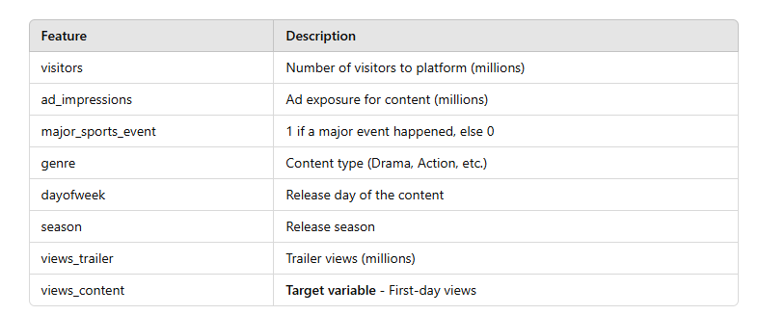
Dataset Overview and Key Features

Slide 5
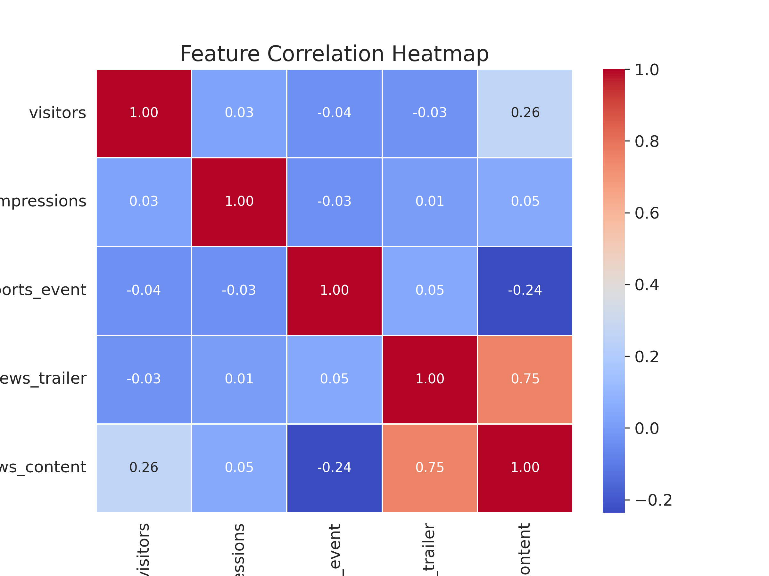
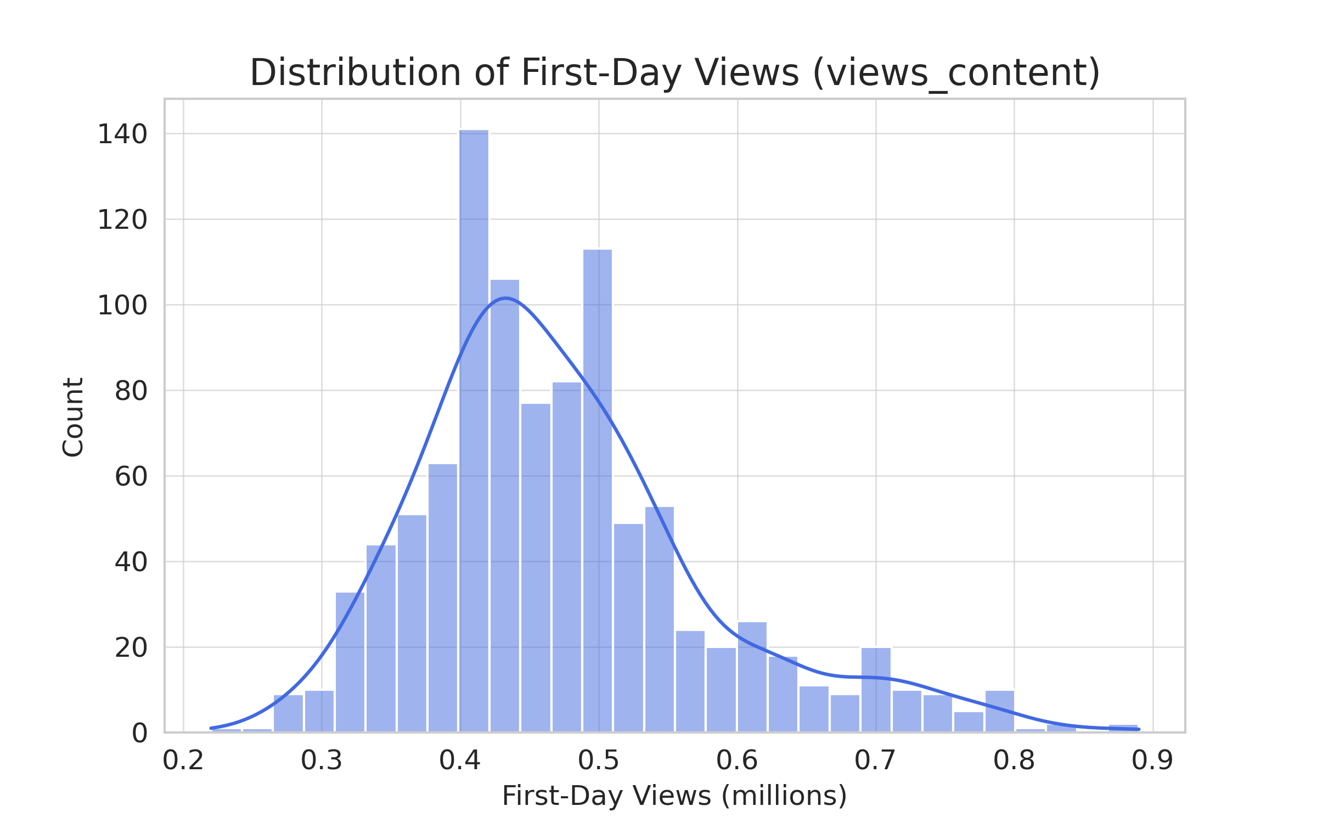
Bivariate Analysis Relationships Between Features Data distribution/Relationships
Trailers matter. Content with more trailer views get higher first-day views.
More visitors, more views. Even a little more platform visitors leads to better content performance.
Sports events hurt viewership. Major games hurt first-day views and they tend to drop.
Most content lands in the middle. A few shows do really well, but most get between 0.4-0.5M views.

Slide 6
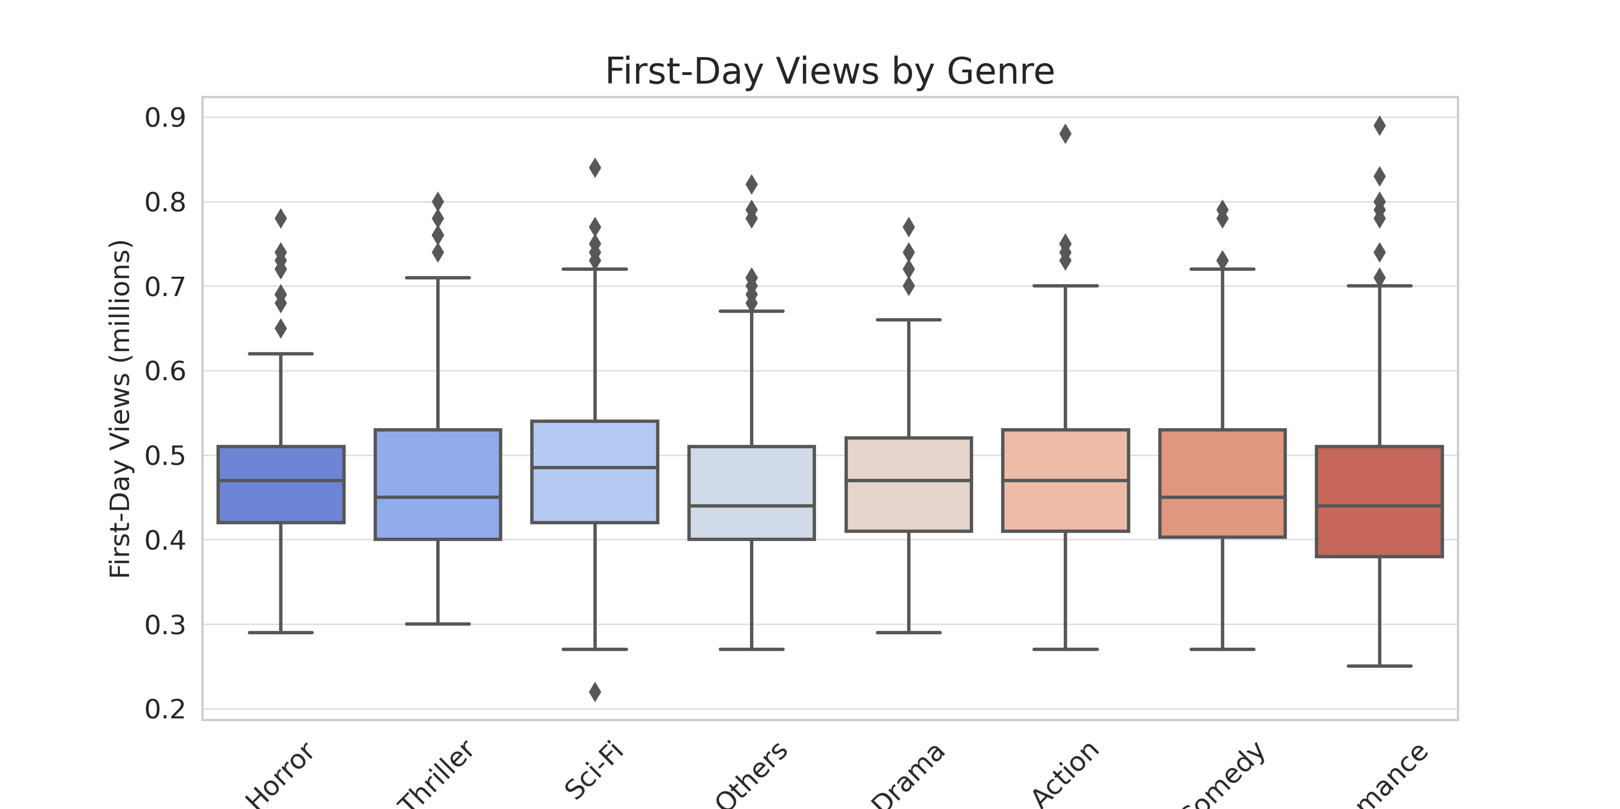
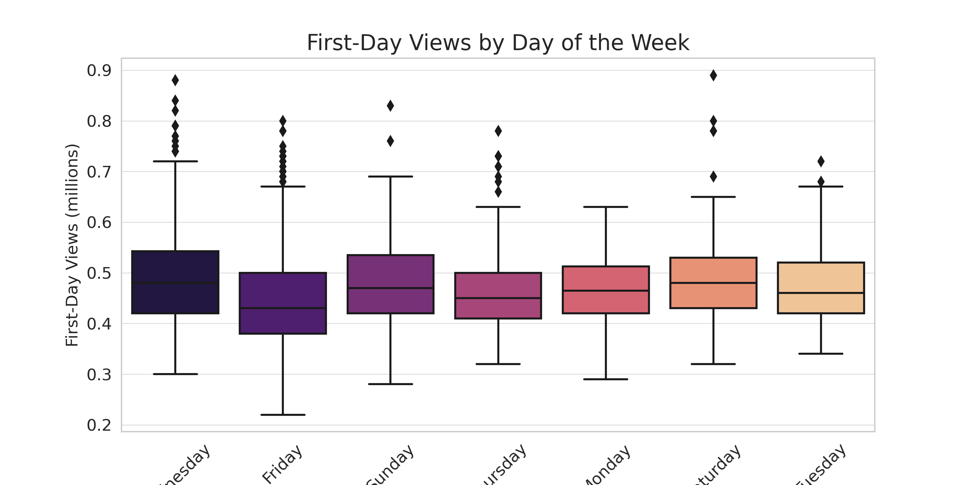
Feature Impact
Action, Thriller genres have highest first-day views.
Releases on FRIDAYS and SATURDAYS perform best.

Slide 7

Insights from Feature Impact
Genres with the highest first-day views:
Action & Thriller content performs best.
INSIGHT: These genres may have stronger audience anticipation or marketing impact.
Best release days:
Fridays and Saturdays have the highest viewership.
INSIGHT: Viewers prefer watching new content on weekends when they have more free time.
Impact of Sports Events:
Major sports events reduce first-day viewership.
INSIGHT: Competing with live events lowers engagement.

Slide 8

Data Preprocessing
Steps Taken:
Missing Values: Conducted a thorough check and confirmed no missing data.
Outlier Detection & Treatment: Identified and addressed outliers in key variables to improve model stability.
Categorical Encoding: Transformed categorical variables (genre, dayofweek, season) into numerical representations for model compatibility.
Data Splitting: Partitioned the dataset into training (70%) and testing (30%) subsets to evaluate model performance effectively.

Slide 9

Model Building - Linear Regression
• Approach: Ordinary Least Squares (OLS) Regression.
• Initial Model Summary:
- Display R-squared and adjusted R-squared values.
- Significant predictors (e.g., visitors, views_trailer, major_sports_event).
- Dropped insignificant predictors based on p-values.

Slide 10

Testing Model Assumptions
• Multicollinearity: Checked using VIF (dropped variables with VIF > 5).
• Linearity & Independence: Residual plots.
• Normality: Shapiro-Wilk test and Q-Q plot.
• Homoscedasticity: Goldfeld-Quandt test.

Slide 11

Model Performance Evaluation
Performance Metrics:
- RMSE, MAE, MAPE for train and test data.
Comparison Between Models:
- Show results before and after removing multicollinearity & high p-value variables.
- Final Model: R-squared, Adjusted R-squared, and performance metrics.

Slide 12
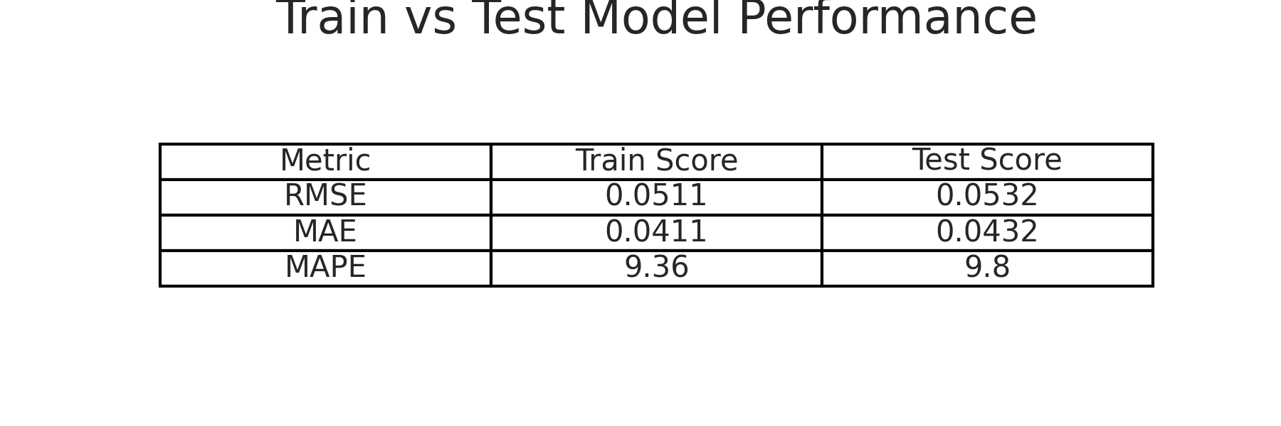
Train vs Test Performance
Test RMSE was slightly higher than train RMSE, meaning slight overfitting (but within acceptable range).

Slide 13

Actionable Insights & Recommendations
Key Takeaways:
Higher visitor count and trailer views lead to higher first-day views.
Major sports events negatively impact content viewership.
Release timing matters—weekends perform better.
Recommendations:
Increase marketing efforts for high-traffic periods.
Optimize release schedules to avoid competition with major sports events.
Focus on genres that perform best.

Slide 14

Conclusion and Next Steps
Summary:
The model predicts first-day viewership with 74% accuracy.
Next Steps:
Test advanced models (Random Forest, XGBoost) to improve accuracy.
Analyze viewer reviews to check if sentiment affects watch rates.
Collect more data (age, demographics, device type) to refine predictions.

